Slide 1
Jetpack lifecycle-aware
(Android)
By: Sohaib Ahmed (Tech Lead)

Slide 2
Activity Lifecycles
onCreate
onStart
onResume
onRestart
onPause
onStop
onDestroy

Slide 3
Lifecycle Aware
Lifecycle-aware components perform actions in response to a change in the lifecycle status of activities and fragments.
These Lifecycle-aware components help us to produce better-organized, and often lighter-weight code, that is easier to maintain.
Lifecycle aware components are divided into 2 parts:
Lifecycle Owner
Lifecycle Observer

Slide 4
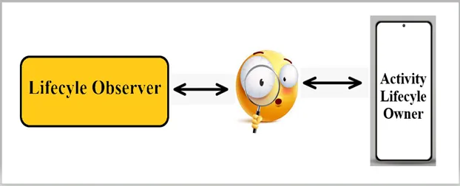
Lifecycle Observer

Slide 5
LifeCycle (Owner VS Observer)
Lifecycle Owner | Lifecycle Observer
It is a component that has a lifecycle, such as an activity or a fragment. | These are components that are interested in changes to the lifecycle state of a lifecycle owner.
It provides information about its lifecycle state to other components, known as lifecycle observers. | They can register with a lifecycle owner to be notified of these changes.
Can have multiple observers to register with. | Can then respond to these events accordingly.

Slide 6
Benefits of lifecycle-observers
Decouples code:
Lifecycle owners and observers decouple the code that implements the lifecycle from the code that needs to respond to lifecycle events. This makes the code more modular and reusable.
Reduces boilerplate code:
Lifecycle owners and observers can help to reduce boilerplate code in your app. For example, you don't need to manually check the lifecycle state of a component before performing certain operations.
Improves performance:
Lifecycle owners and observers can help to improve the performance of your app by ensuring that resources are only used when they are needed.

Slide 7
Ways to Implement
OnLifeCycleEvent (deprecated)
DefaultLifecycleObserver
LifeCycleEventObserver

Slide 8
ProcessLifecycleOwner
Class that provides lifecycle for the whole application process.
You can consider this LifecycleOwner as the composite of all of your Activities except that Lifecycle.Event.ON_CREATE will be dispatched once and Lifecycle.Event.ON_DESTROY will never be dispatched.
It will dispatch Lifecycle.Event.ON_START, Lifecycle.Event.ON_RESUME events, as a first activity moves through these events.
Lifecycle.Event.ON_PAUSE, Lifecycle.Event.ON_STOP, events will be dispatched with a delay after a last activity passed through them.
Note:
It is useful for use cases where you would like to react on your app coming to the foreground or going to the background and you don't need a milliseconds accuracy in receiving lifecycle events.

